Slide 1

Data-Related Job Salaries
Ricardo Torres
Franklin Ledesma

Slide 2
Project Overview
This project started out with simple curiosity. We wanted to know if the industry of data was growing of descending. We asked ourselves what positions or specific jobs had the better average salaries. The location was also a key factor for our questions and we wanted to know where we could find the best salaries. We started our project based on these questions and new ones came up as we worked on the project.
The original datasets were, thankfully, very clean. Unlike the people who document shark attacks, job salaries are apparently easier to document. The data sets had lots of information but we identified the most relevant columns which were:

Slide 3
Project Overview
Before starting the data wrangling and cleaning, we formulated these 5 hypothesis:
The data-related job salaries are increasing.
Data Science is the best paid data-related job in the industry.
New York is the state with the best salaries.
There’s no significant difference between remote jobs and non-remote jobs.
The experience level with better average salary is the Senior Level.
The project plan was very straightforward.
Clean the datasets (Datasets Source: https://www.kaggle.com/)
Applied the analysis to each individual dataset (Salaries,Glassdoor and combined datasets).
Create the presentation

Slide 4
Data Wrangling and Cleaning
For the cleaning process, even though the data was very clean, we still had to integrate and modify some things.
We removed the columns that weren’t going to be useful for the project.
We removed null values using dropna( ) built-in function.
One uniquely challenging part was the salary column in one of the datasets because, instead of displaying the annual salary, it had values of hourly rate and monthly rate. We had to make a function to convert every value to display the yearly income.
We also used a lambda function to clean the ‘remote_ratio’ column by assigning a ‘1’ to the remote positions and ‘0’ to the non-remote positions.
Another challenge we faced was to clean the location column where one dataset had values like: ‘San Francisco, CL’ , ‘Miami, FL’ , ‘Houston, TX’. It was easy enough to extract the last two letters but there were also values that the function didn’t apply to them so we had to identify those values, exclude them and apply their own cleaning process. It was complex but nonetheless we succeeded.
Much more data cleaning techniques like: ‘.rename’ , ‘.concat’ , ‘.groupby’ , etc.

Slide 5
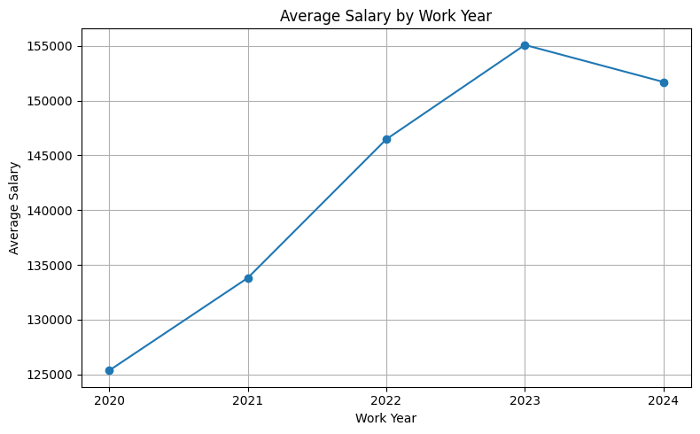
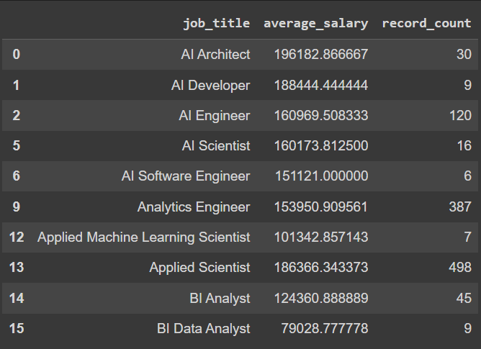
Exploratory Data Analysis
By creating a line plot graph, we can see that the average data-related salaries have increased throughout the years except for this current year. It is still not the end of the year so the results might change.
Here we can see a created table that displays the average salary of each specific position and their record count. It seems that the ‘AI’ sector is the one with the highest average salary.

Slide 6
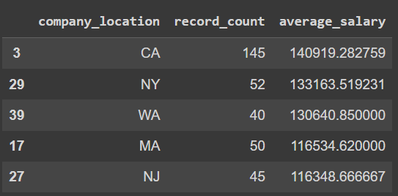
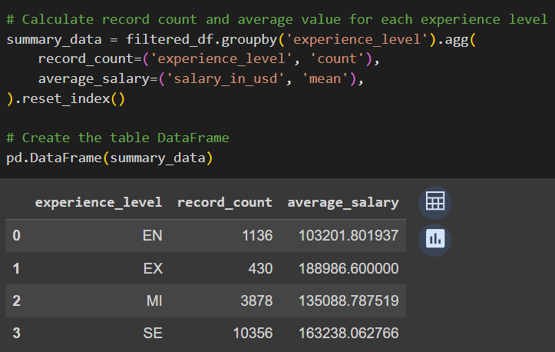
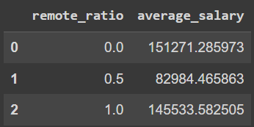
Exploratory Data Analysis
This table shows the states with the best average salary. We might consider moving to California or New York in the future.
Entry Level (EN)
MI (Mid level)
Senior (SE)
Executive (EX)
There is no significant difference between remote jobs and non-remote jobs.

Slide 7
Teamwork & Project Management
WORKFLOW
We mostly followed the expected workflow of a data analysis project. We searched and gathered the data we wanted which actually took us 2 days. When we finally decided on the datasets we wanted to use we studied the raw data, cleaned it and structured it; that took us another day. For the final day we analyzed the results, got our conclusions and created this presentation.
TEAMWORK
Our partnership was purely created by fate. One member was planning on doing the project alone and the other wasn’t in the morning the groups were created. We got paired having no expectations but ended up working great together. We both worked equally and had great communication.

Slide 8
Major Obstacles
OBSTACLES
One of our mayor obstacles was time. We think that we should have better visualization of our results and probably find better quality datasets.
Also, we wanted to keep working after-hours but we were limited by our responsibilities outside the bootcamp.
WHAT DID WE LEARN?
We need to keep learning and have more experience to do a better assessment and as a result we will have a better time management.

Slide 9
Conclusions and Insights
Our hypothesis were not entirely supported.
The data-related job salaries are increasing. (SUPPORTED)
Data Science is the best paid data-related job in the industry. (REFUTED)
New York is the state with the best salaries. (REFUTED)
There’s no significant difference between remote jobs and non-remote jobs. (SUPPORTED)
The experience level with better average salary is the Senior Level. (REFUTED)
Not everything we predicted was supported and the results of the salaries were a lot higher than we thought. Nonetheless, the numbers don’t lie and we know we executed a great project.

Slide 10





THANKS FOR YOUR ATTENTION!
Project name: Data-Related Job Salaries
Members: Ricardo Torres & Franklin Ledesma

